Slide 1
ShanghaiTech University
EE 115B: Digital Circuits
Fall 2021
Lecture 4
Hengzhao Yang
September 30, 2021

Slide 2
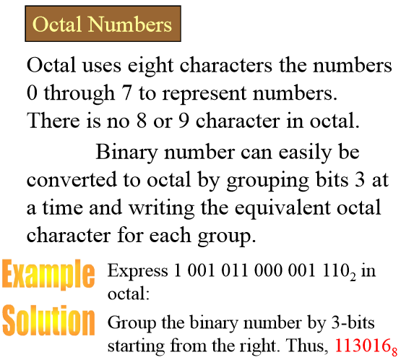
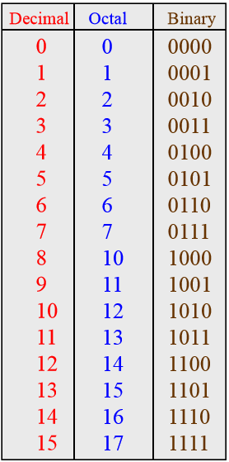
Octal Numbers (1)
Prof. Yajun Ha
Notes:
Title

Slide 3

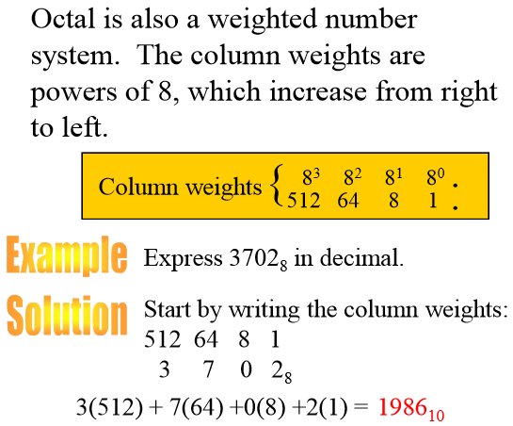
Octal Numbers (2)
Prof. Yajun Ha
Notes:
Title

Slide 4
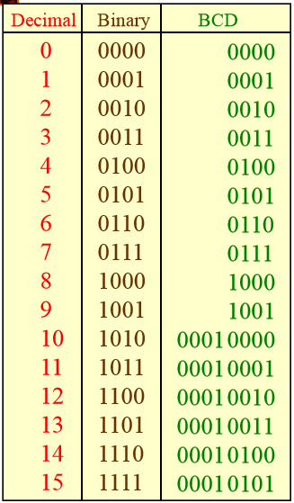
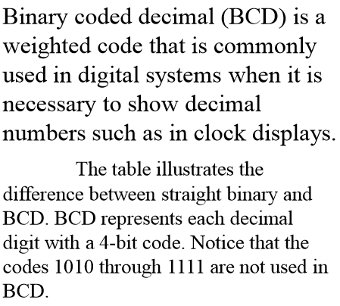
BCD (1)
Prof. Yajun Ha
Notes:
Title

Slide 5
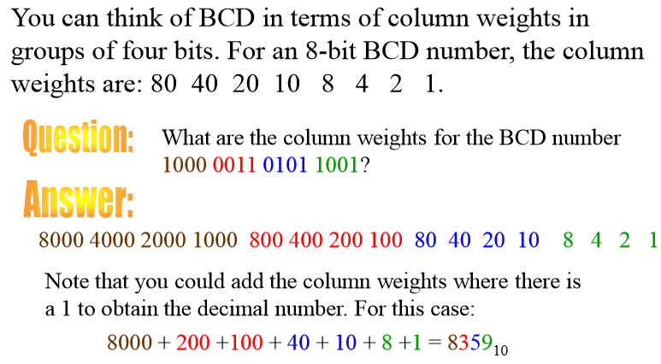
BCD (2)
Prof. Yajun Ha
Notes:
Title

Slide 6
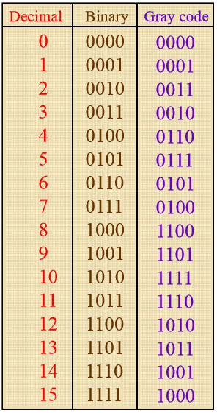
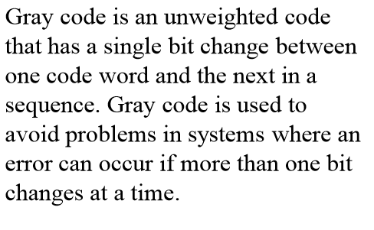
Gray Code (1)
Prof. Yajun Ha
Notes:
Title

Slide 7
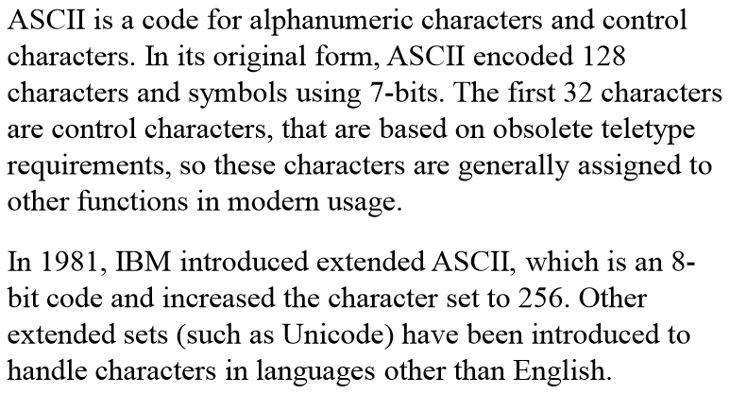
ASCII
Prof. Yajun Ha
Notes:
Title

Slide 8
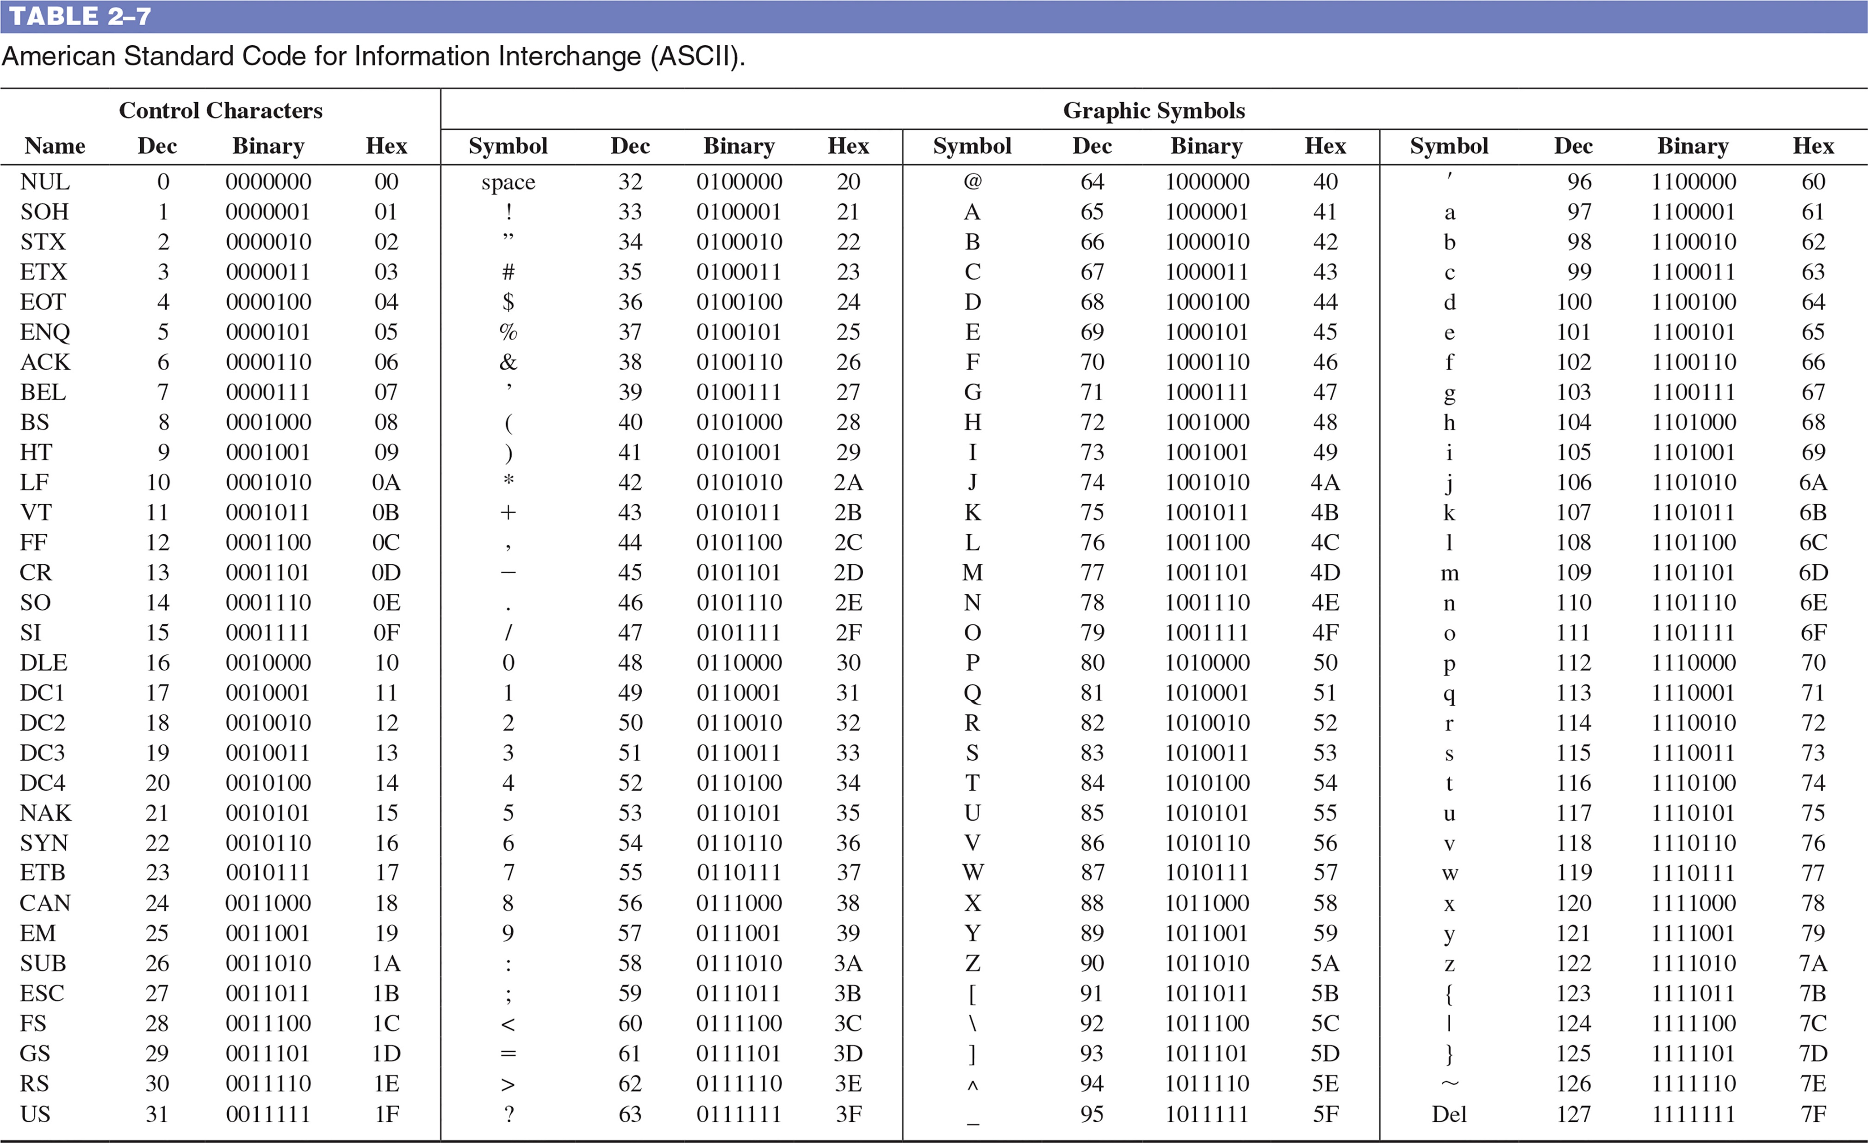
TABLE 2–7 American Standard Code for Information Interchange (ASCII).

Slide 9
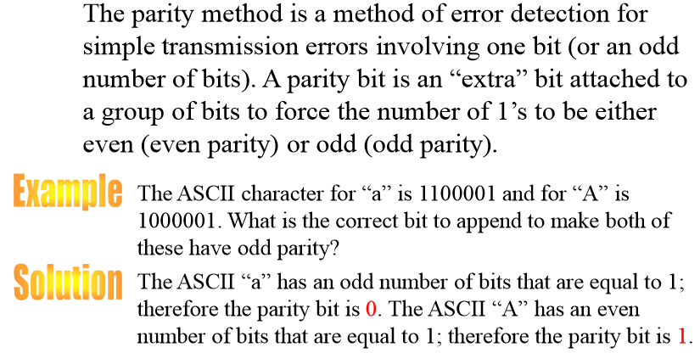
Parity Method
Prof. Yajun Ha
Notes:
Title

Slide 10
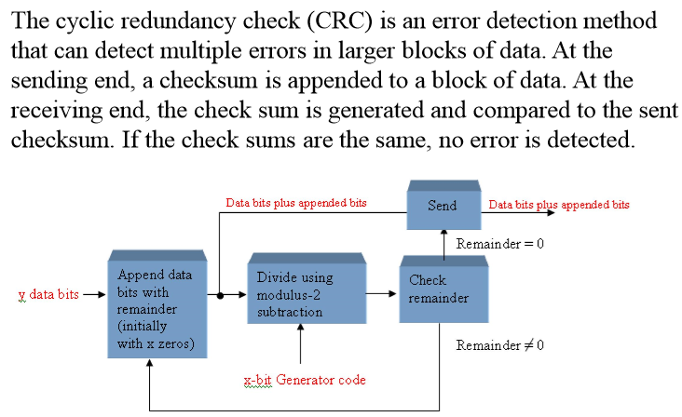
Cyclic Redundancy Check
Prof. Yajun Ha
Notes:
Title

